Slide 1
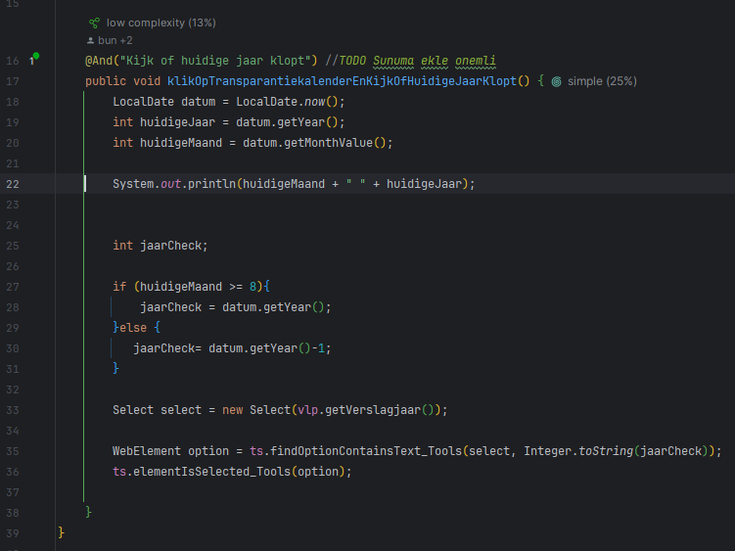
Transparantiekalender

Slide 2
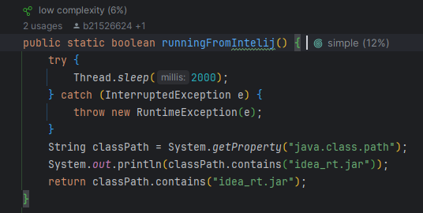
RunningFromIntelij

Slide 3

addFile

Slide 4
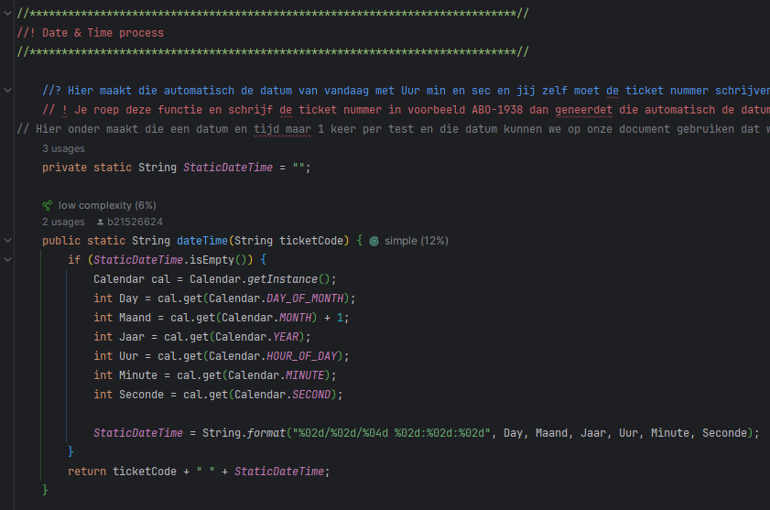
dateTime

Slide 5

recursiveFuntion

